Slide 1
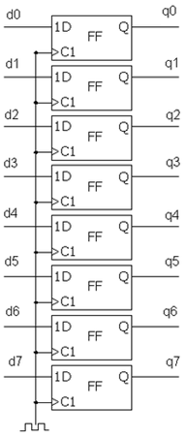
D
1Q
Shift
Register
2Q
3Q
רגיסטר 8 סיביות
Flip-Flop
יחידת חישוב
1D
Q
FF
ALU
C1
1D
Q
FF
MUX
C1
1D
Q
ENA
FF
C1
Counter
Compare

Slide 2
sel
Decoder
output
Decoder
input
Sel[0..0]
in
Out[1..0]
0
Din valid
Output_0
clk
Simple RAM
Data out
Data in
0
Output[1..0]
Addr in
input
Addr out
Dout valid
Output_1
Aout valid
RAM data
Simple RAM
Din valid
WE
clk
CLK
Data in
DATA OUT
Data out
DATA IN
1D
Q
Addr in
ENA
FF
WADDR
Addr out
C1
RADDR
Aout valid
dout valid
1D
Q
ENA
FF
C1

Slide 3
Addr in
sel
Decoder
output
Din valid
Reset
input
clk
Simple RAM
Data out
Data in
Addr in
Data in RC
Clk
Addr out
Dout valid
Aout valid
Data in RAM
dout valid
Din valid
clk
Simple RAM
Data out
Data in
Addr out
Addr in
Addr out
Dout valid
Aout valid
aout valid
Generics

Slide 4
REG_mux
‘0’
Trigger Type
Reset
Trigger Position
REG_input
Clk to start
Enable
Trigger Type
Trigger Position
Clk to start
Enable
Clk

Slide 5
Counter
Clk
RC finish
Reset
1D
Q
FF
Start addr in
C1
Trigger found
Curr addr out
Addr to RAM
ALU
Next addr out
WC finish
1D
Q
FF
C1
Dout valid
Data from RAM
ALU
Data to coordinate
1D
Q
FF
C1

Slide 6
Trigger
‘0’
Trigger found
Reset
Trigger
Position
Aout valid
Trigger
Type
ALU
Start Address
ENABLE
First addr
next addr
ALU
Addr in RAM
Current addr
1D
Q
FF
Data in
C1
Data in RAM
1D
Q
FF
Clk
C1

Slide 7
Clk
Reset
Data in valid
Data out valid
1D
Q
ALU
Data out
Data in
FF
C1

